Slide 1
LAMIS Treatment Continuation Features
February 2021

Slide 2
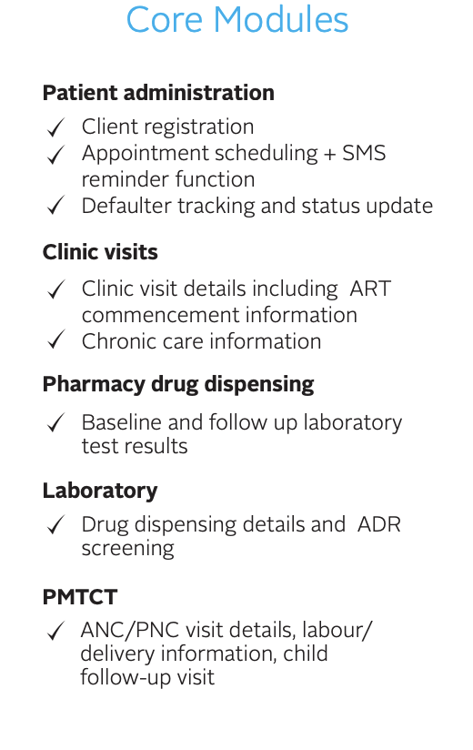
About LAMIS
LAMIS is acronym for Lafiya Management Information System
Lafiya is a word meaning health or wellbeing in about 5 different African languages
Electronic Medical Records (EMR) software developed under the GHAIN project through PEPFAR funding by indigenous Nigerian manpower
Manages client level data of patients enrolled for HIV chronic care including ART
LAMIS 3.0 developed under SIDHAS project as scalable, web-based application
A new version LAMISPlus 1.0 is currently under pilot testing. This version is a general purpose EMR designed to run in a real time environment

Slide 3
Treatment Continuation Features
SMS Reminders
Case Management
Clinic Visits
Drug Refills
Viral Load Investigations
Appointment List
Defaulters List
Client Status Notifications
LAMISLite Notifications
Appointments
Defaulters
Treatment Failures
Appointments
Defaulters
Treatment Failures

Slide 4
SMS Reminder System
The SMS Reminder module is capable of sending clinic, drug refill and viral load investigation reminders to clients
Operation Procedures
Clients must subscribe to SMS reminder by signing a consent form
SMS reminders can be sent in your preferred language
The message sent to a client does not reveal any health status for confidentiality reasons
SMS are sent to a client 3 days to his/her appointment date (this is configurable)
A client can send a specially formatted message to a short code to receive information on his/her appointments
Implementation options
SMS reminder system uses an SMS Gateway implemented on the LAMIS central server. This requires facilities to sync their data on a daily basis
At facility level a user can activate the modem based SMS reminder system. This option does not require an internet connection

Slide 5
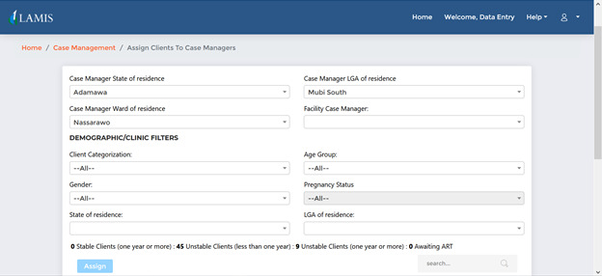
Case Management Module
This module allows a facility to assign a number of clients to a Case Manager
A Case Manager can generate a list of his/her clients appointment information and place a call to them
A Case Manager can also generate a list of his/her clients that have defaulted for any appointment and follow them up with a phone call or home visit in some cases

Slide 6
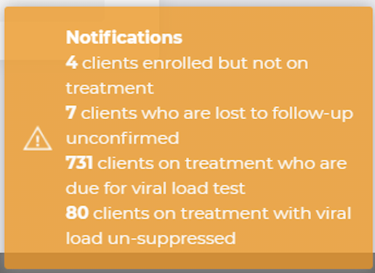
Client Status Notification
Whenever a user logs into LAMIS, the system automatically runs an analysis on the database and presents a user with a floating notification bar that shows the following information
Number of clients that have defaulted for clinic or drug refill appointment
Number of clients that are virally unsuppressed
Number of clients that due to viral load investigation

Slide 7
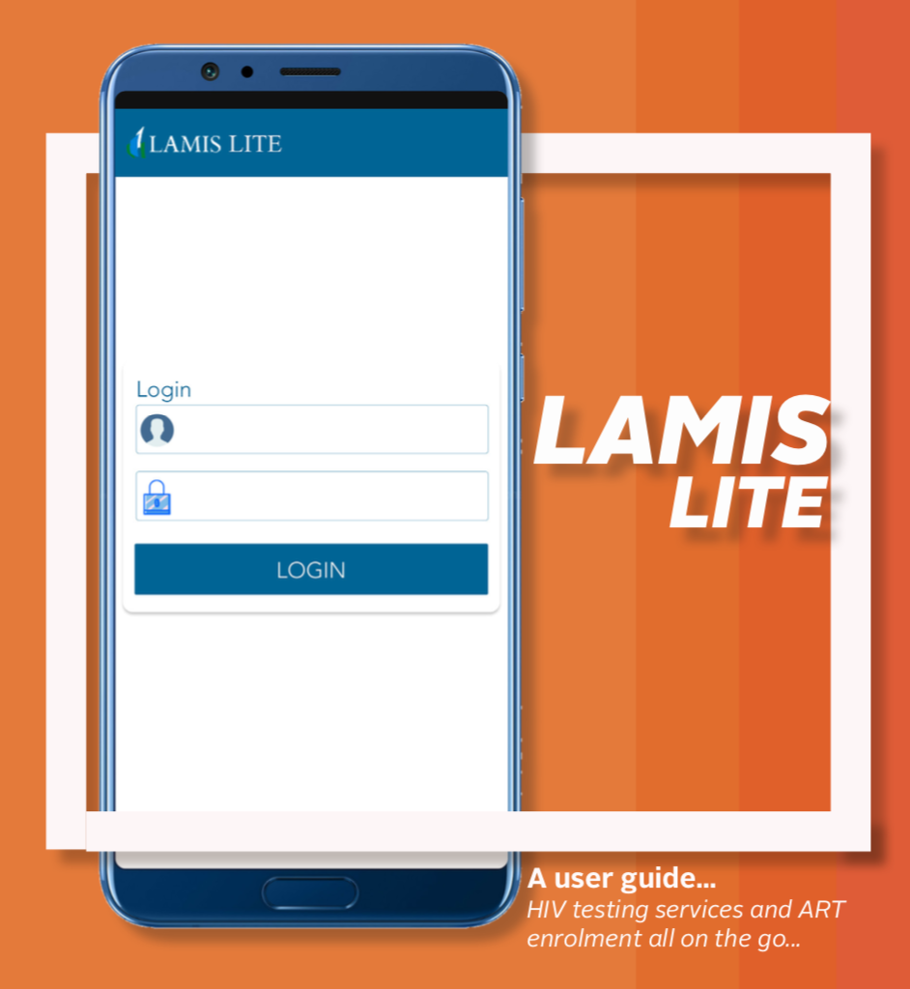
LAMISLite Mobile App
LAMISLite is the mobile version of LAMIS. The app interact with the LAMIS Central Server to pull real time information on clients.
A user can only see information of clients in his/her facility
The app allows a user to capture clients data and sync to the central server
User can get notification on appointments, defaulters and clients treatments status

Slide 8
Data for Implementation (Data.FI) is a five-year cooperative agreement funded by the U.S. President’s Emergency Plan for AIDS Relief through the U.S. Agency for International Development under Agreement No. 7200AA19CA0004, beginning April 15, 2019. It is implemented by Palladium, in partnership with JSI Research & Training Institute (JSI), Johns Hopkins University (JHU) Department of Epidemiology, Right to Care (RTC), Cooper/Smith, IMC Worldwide, Jembi Health Systems and Macro-Eyes, and supported by expert local resource partners.
This presentation was produced for review by the U.S. President’s Emergency Plan for AIDS Relief through the United States Agency for International Development. It was prepared by Data for Implementation. The information provided [in this document] is not official U.S. government information and does not necessarily reflect the views or positions of the U. S. President’s Emergency Plan for AIDS Relief, U.S. Agency for International Development or the United States Government.

