Slide 1
RWANDA HIE
PATIENT IDENTITY MANAGEMENT

Slide 2
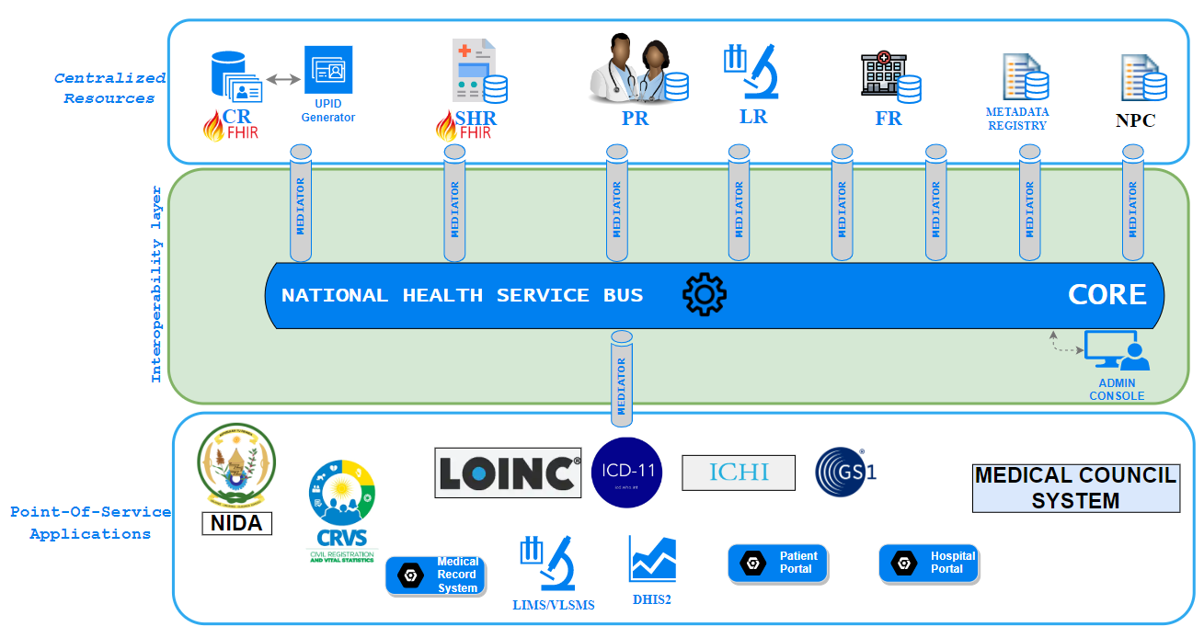
BACKGROUND : RHIE Architecture

Slide 3
PIM – GOALS for Rwanda Healthcare
Uniquely identify each individual (patient) seeking care from any health facility across the country.
Maintain a set of identifiers in the client registry associated with a patient.
Avoid duplication of patient records within the client registry and in Local EMR systems.

Slide 4
How PIM helps us achieved our Goals
Provide a mechanism to centrally manage patient demographics information and all their associated Identifications
A single source of patient demographics information (National Identification Agency in our case) ensures a high percentage of citizens/patient can be uniquely identified without the need to match one patient’s data from multiple sources

Slide 5
Current Implementation : Citizen Identity
National Identity Agency (NIDA) | Document Number (16 digits with a defined logic) NIN (caters for NEWBORNS & UNDER 16s) Application Number (8 digits) Foreigner ID | Validated via NIDA system
Civil Registration & Vital Status (CRVS) | NIN (Newborns & U16) | Validated via CRVS system
INSURANCES | Insurance Card Number | Not Validated
Travel Documents | Passport number | Not validated
UPI | Unique Patient Identifier: Generated by a UPI service connected to CR Format: 220811-1140-3040 -> YYMMDD-FOSAID-RAND4 | Validated via Client Registry

Slide 6
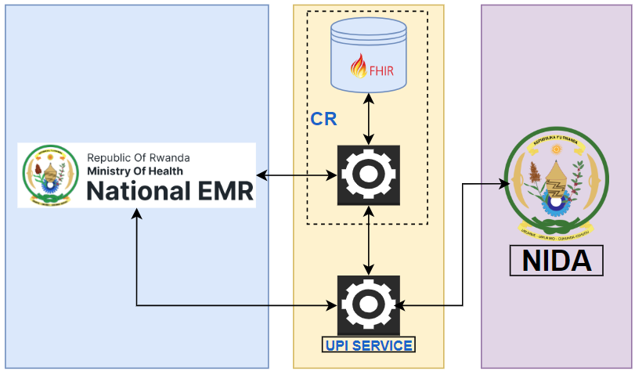
Current Implementation : Client Registry

Slide 7
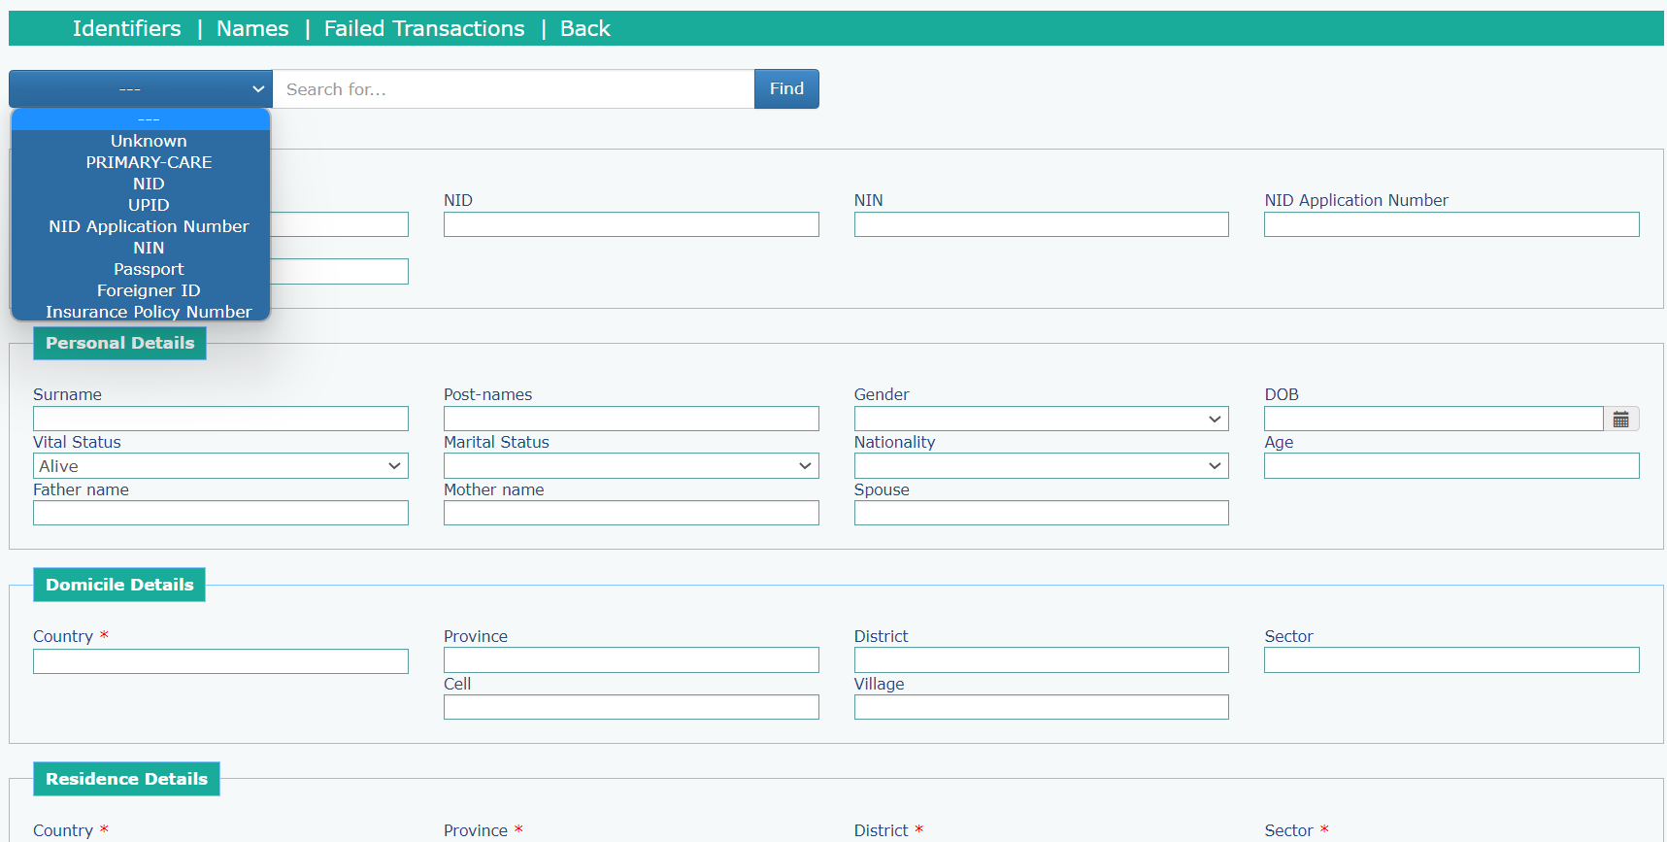
Registration Page in Current National EMR

