Slide 1
Digital health for patient retention (Neno District, Malawi)
February 9th 2021
Limbani Thengo

Slide 2
Outline
Background
Integrated Chronic Care Clinic (IC3)
Present day
Appointment report
TRACE
Integration with Medic Mobile (YendaNafe)

Slide 3
Background
2007: PIH and started customizing OpenMRS for Neno District HIV program
2015: Integrated Chronic Care Clinic launched (Combining HIV & NCD care)
2018: Advanced NCD clinic open
2019: Point of Care screening application implemented

Slide 4
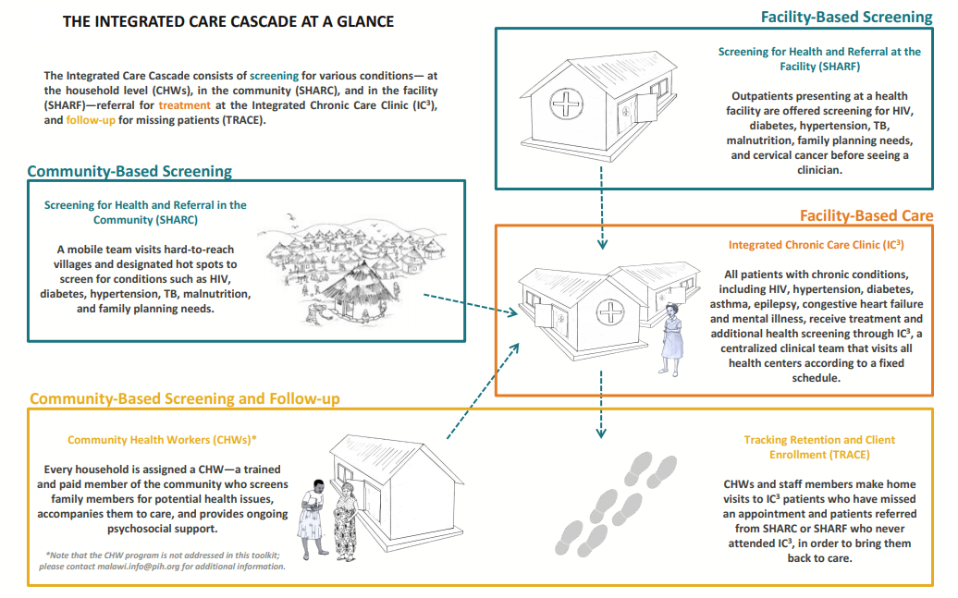

Slide 5
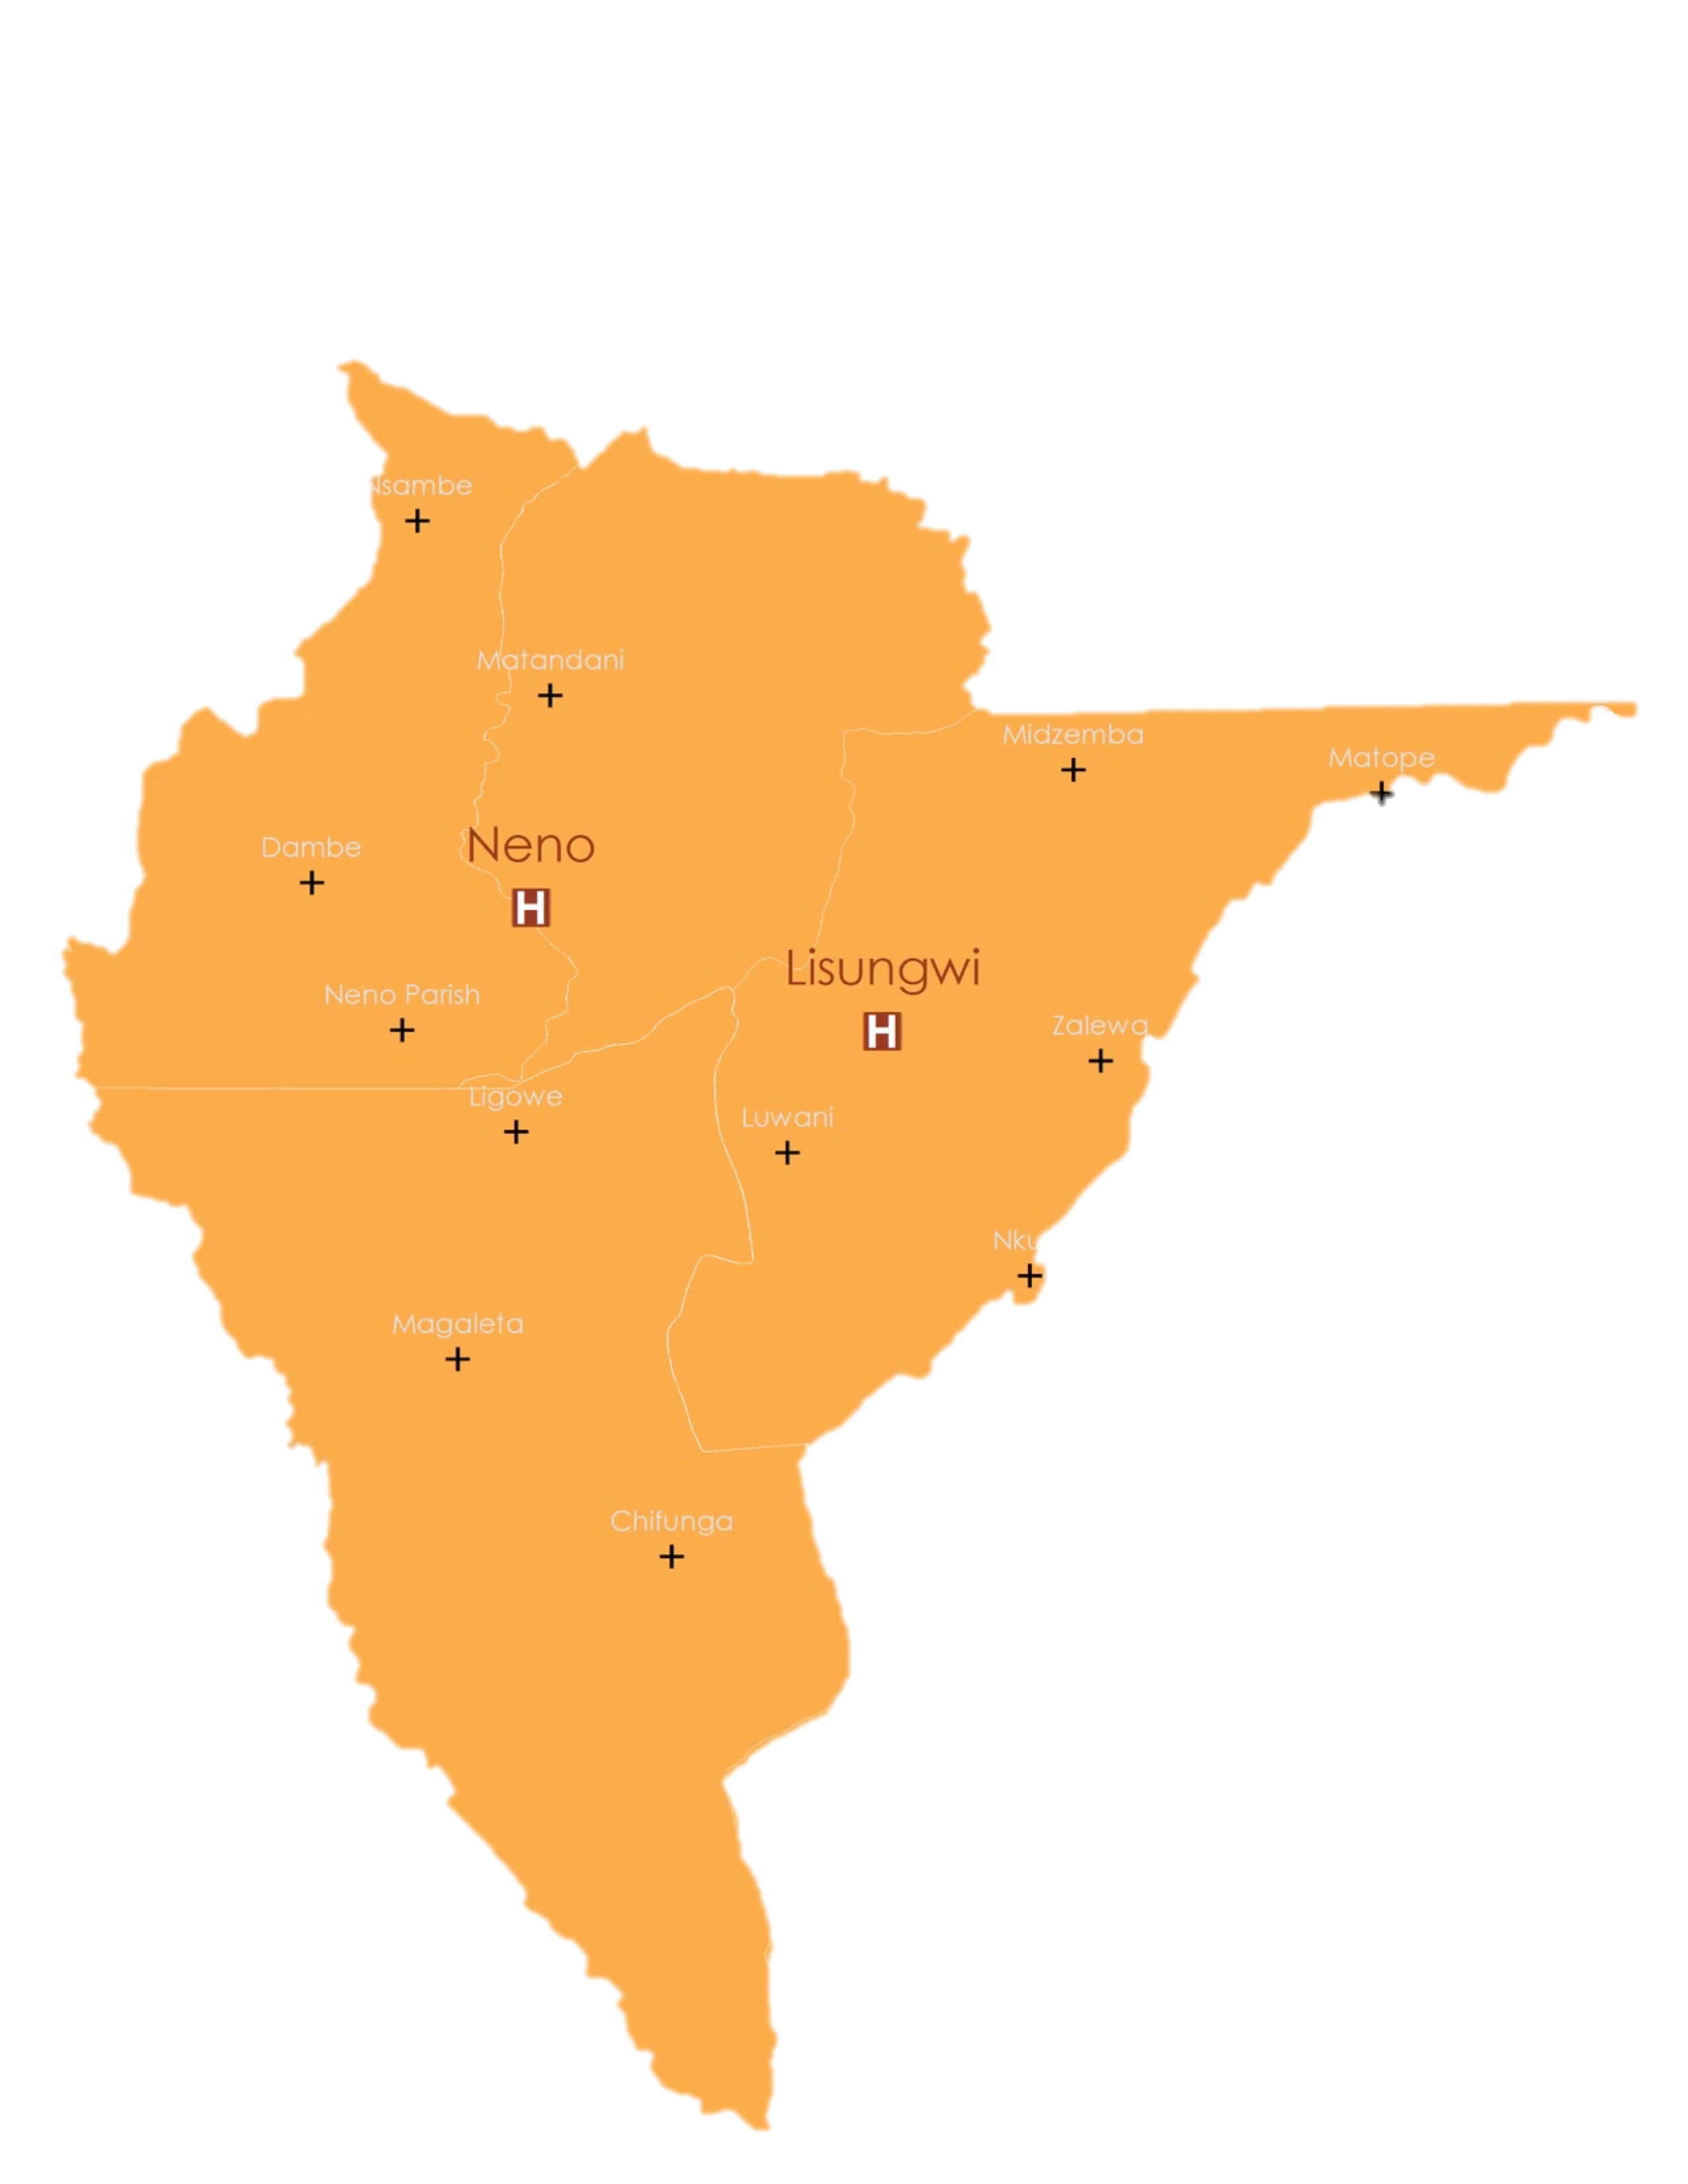
2021 - today
8,531
4,412
HIV PATIENTS
active in care
NCD PATIENTS
active in care
14
FACILITIES
supported by OpenMRS

Slide 6
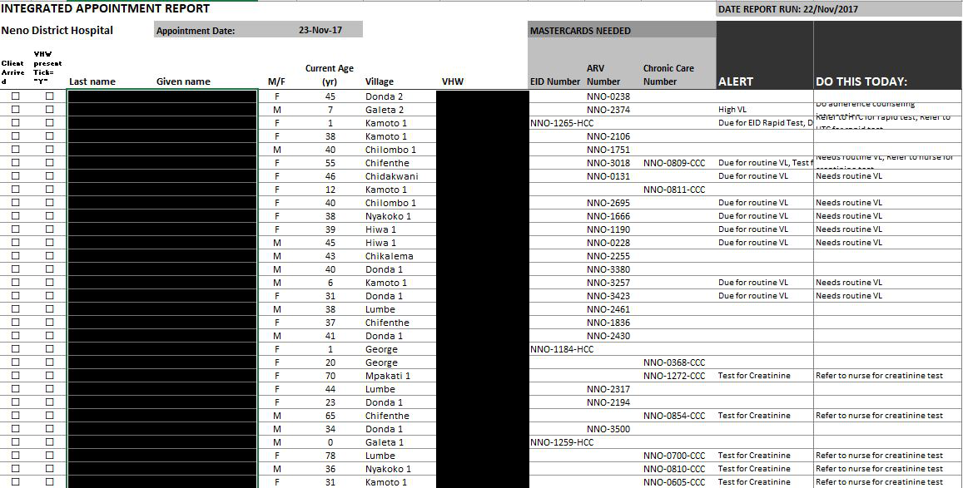
Appointment Report

Slide 7
Tracking Retention and Client Enrollment (TRACE)
Two weeks report
Six weeks report
Two weeks report
CHWs alert HIV and NCD clients who
recently missed an appointment
have urgent lab results
need a lab test
IC3 TRACE team follows
HIV clients who have not made it back into care 6w after missed appointment or urgent lab results
NCD clients who have been out of care more than 6 weeks and are high priority, (e.g. Stage 3 HTN clients or diabetic client on insulin)

Slide 8
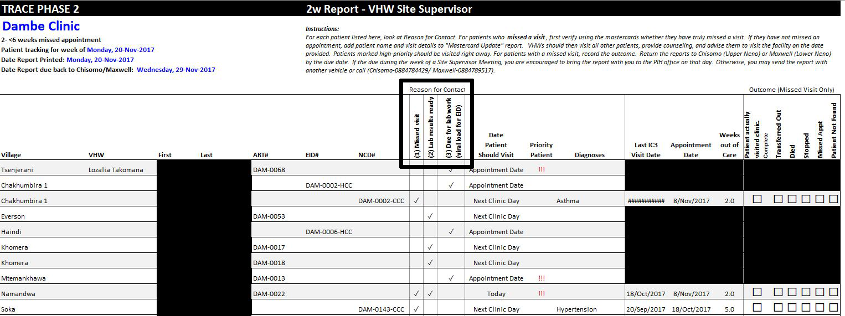
Tracking Retention and Client Enrollment (TRACE)

Slide 9
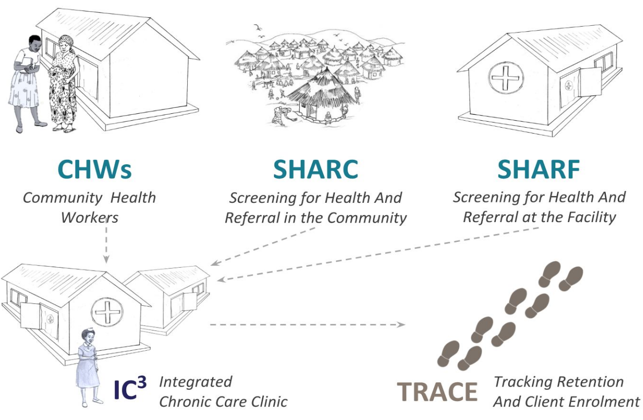
OpenMRS - Medic Mobile Integration

Slide 10
Zikomo!
(Thank You!)

